Slide 1
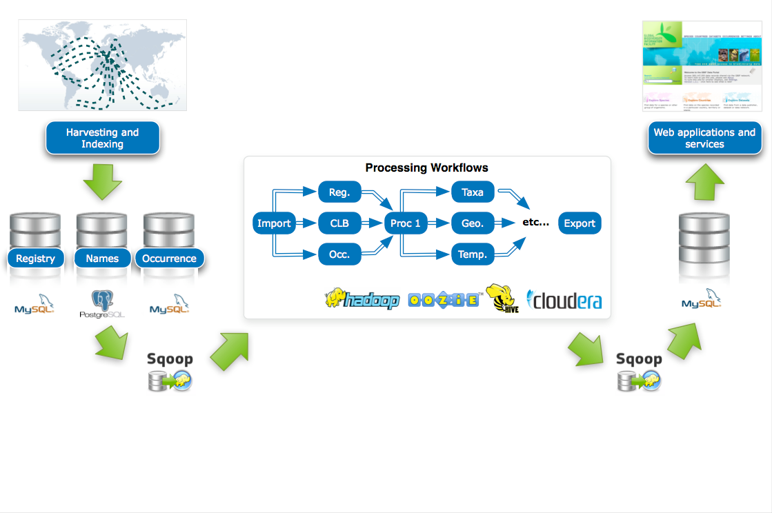
Sqoop Introduction

Slide 2
Sqoop
A tool designed to transfer data between Hadoop and RDMS.
Sqoop uses Map-Reduce to import and export the data

Slide 3
Sqoop Scenario
Want to convert RDMS to Hadoop to solve big-data problem

Slide 4
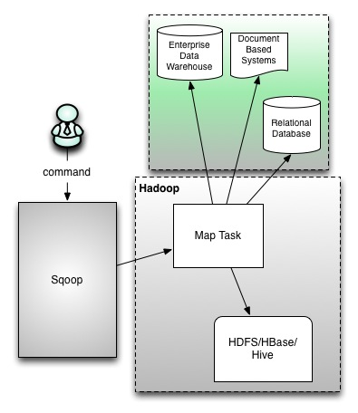
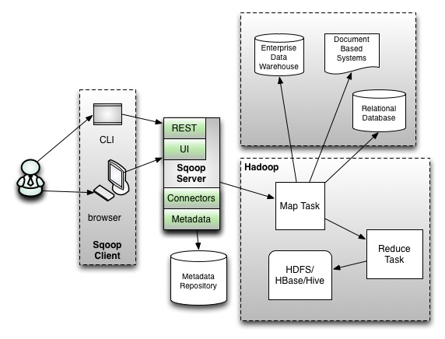
Sqoop1 vs Sqoop2
Current use Sqoop1, Sqoop2 still developing
Sqoop1
Sqoop2
Only Command Line
Can write code

Slide 5
Demo
Postgres RDBMS to Hive
Postgres RDBMS to Hbase

Slide 6
Thanks for your attention

